Slide 1


Unix shell Introduction

Slide 2

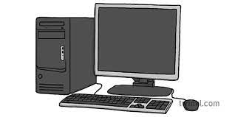
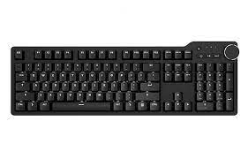

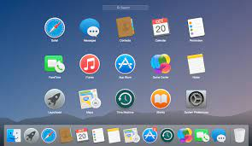


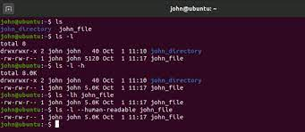
Background : Human interaction with computers
Keyboard
GUI
Touch screens
Mouse
Voice recognition
systems
CLI

Slide 3


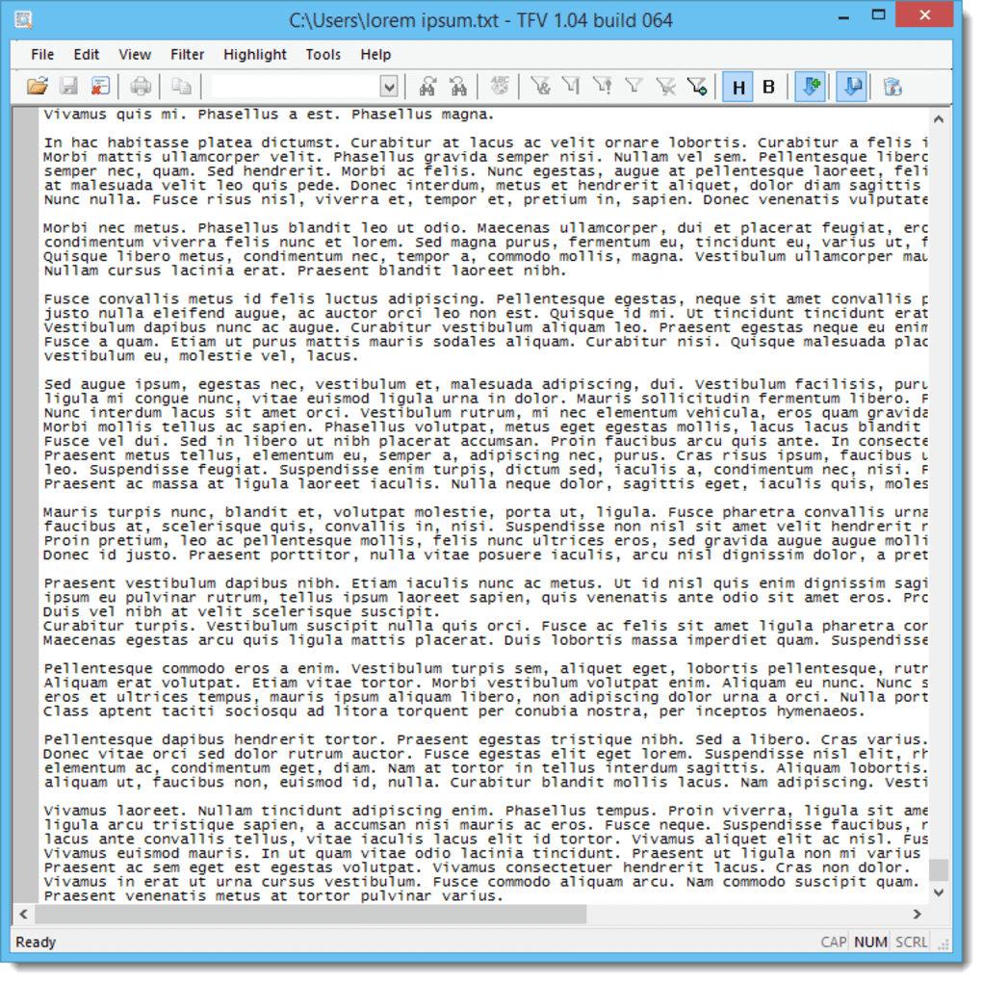




However, the GUI scales poorly with repetitive tasks
50 directories
Example:
Time, Energy
copy
paste
# of
repetitive tasks
CLI

Slide 4

Key points
The Unix shell has been around for decades, older than most of its users.
Its longevity comes from being one of the most productive programming environments ever created.
Graphical interfaces feel easier initially, but the Unix terminal/shell offers high productivity once learned.

Slide 5

Concepts clarification
Unix (operative system)
Shell (command line “language” to communicate to OS)
Terminal (User interaction to the shell )
Bash (a type of Unix shell)
Unix shell? Or Bash ? Or terminal?
Notes:
Unix is the whole operating system, while shell is a program on Unix that takes commands from the user and gives them to the OS to process.
A terminal is the tool you use to run a shell session, providing a user interface to access the Unix shell.
Bash is a specific type of shell, offering more advanced features compared to some other shells.
In summary, when you open a terminal, you are using a GUI or textual interface to access a shell-like Bash, which in turn interacts with the Unix operating system to execute commands and run programs.

Slide 6
What are we going to use today?
Depends on your OS!
A lightweight Bash emulation on Windows that comes with Git for Windows.
Windows
Git bash
The "classic" command-line environment on Unix-like systems
macOS/Linux
Unix shell

Slide 7
Unix shell
Bash is the default shell on most modern implementations of Unix.
Git Bash is a piece of software that enables Windows users to use a Bash like interface when interacting with Git.
The shell is a scripting language; thus, users can type commands.
The grammar of a shell allows you to combine existing tools into powerful pipelines and handle large volumes of data automatically. Sequences of commands can be written into a script, improving the reproducibility of workflows.
The command line is often the only way to interact with remote machines, supercomputers, clusters and cloud computing systems, thus being able to interact with the shell is becoming a necessary skill.

Slide 8
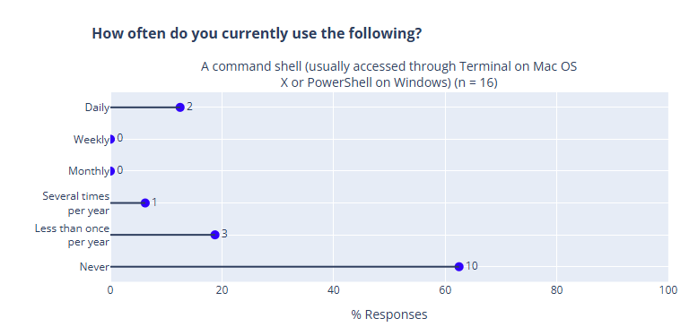
You

Slide 9
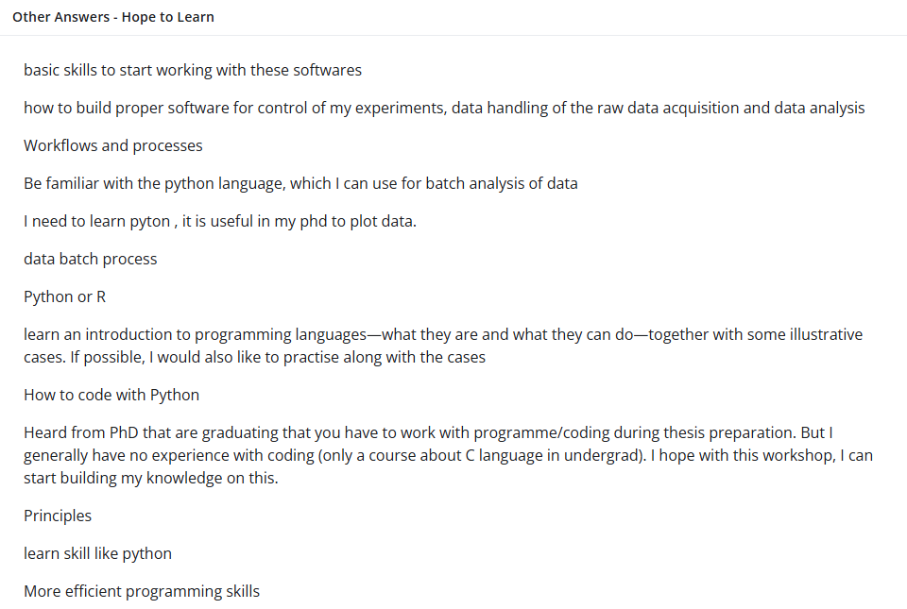
Your expectations for this workshop

Slide 10




By the end of this lesson, we should be capable to help Nelle in her task
Nelle Nemo
Marine biologist
navigating directories and files,
creating and organizing data,
chaining commands together,
automating repetitive tasks with loops and scripts,
and searching efficiently through files.
1520 times!
goostats.sh

Slide 11


Slide 12
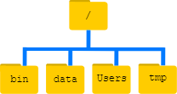
Home directory :/c/Users/maxplanck
Root directory
Notice that there are two meanings for the / character.
When it appears at the front of a file or directory name, it refers to the root directory.
When it appears inside a path, it’s just a separator.
/C/Users/maxplanck/Documents
Notes:
The topmost directory is the root directory that holds everything else. We refer to it using a slash character, /, on its own; this character is the leading slash in /Users/nelle.
Inside that directory are several other directories: bin (which is where some built-in programs are stored), data (for miscellaneous data files), Users (where users’ personal directories are located), tmp (for temporary files that don’t need to be stored long-term), and so on.

Slide 13
